Slide 1

BLOOD BANK APPLICATION
A project report
submitted as a part of the internal evaluation process for the course
15CSE375 ANDROID APPLICATION DEVELOPMENT
By
AMRUTHESH.MP (AM.EN.U4CSE17008)
KIRAN.V.GIREESH (AM.EN.U4CSE17038)

Slide 2
Acknowledgement
We have taken efforts in this project. However, it would not have been possible without the kind support and help of many individuals. We would like to extend our sincere thanks to all of them. We are highly thankful to Mr.Rahul.Varma for his guidance and constant supervision as well as for providing necessary information regarding the project and also for his support in completing the project. We would like to show our gratitude to all our friends who supported by their valuable guidelines. Finally, we are thankful to the Institution and Computer Science Engineering for providing us with the opportunity to work on a project related to the current issues.
AMRUTHESH MP (AM.EN.U4CSE17008)
KIRAN V GIREESH (AM.EN.U4CSE17038)

Slide 3
Project abstract
Our group designed a blood donor app, in which a user can both request for blood as well as donate blood to the required user. The motto of our project is to “BRING A LIFE BACK TO POWER, MAKE BLOOD DONATION YOUR RESPONSIBILITY” A new user can either be registered as a donor or blood recipient. For requesting blood the user used should request an application in order to find a blood donor with appropriate blood group and other functionalities needed.
A new user should register to the application first then only they can access the features of the application. They should register with their respective phone no so that that could be used for contacting them when respective donor’s or requests come across. Donors are matched with the requests when necessary conditions are satisfied with the donor and request, such as blood group etc.
The main purpose of this application is to reduce the number of deaths that are happening because of the failure in getting respective blood groups from the blood bank and donors etc. Our app helps in finding out respective donors within minutes and saving more lives. All the data about the donors are stored in the database. So that when a request comes across with matching credentials it instantly finds the donor. Which will result in saving millions of lives.

Slide 4
SYSTEM REQUIREMENTS
The android device having android version 6.1 or higher.
Internet connection
Gps sensor
User Registration
When the application is opened the user is first prompted to either sign up if the user hasn’t registered yet or he can sign in with his registered mail/phone no
Adding credentials
When a new user is logged in to the application. The user must input the details such as an address, phone number, blood group, medical details etc.
Blood Request
When a user wants a certain type of blood group they should fill up a form in order to match to the donor with necessary conditions satisfied. The form contains details such as blood group, address,(or location using GPS).

Slide 5
FEATURES
Intent
The intent filter specifies the types of intents to which an activity, service, or broadcast receiver can respond to by declaring the capabilities of a component. Android components register intent filters either statically in the AndroidManifest. XML or in case of a broadcast receiver also dynamically via code
AppCompatActivity
AppCompatActivity is a specific type of activity that allows you to use the support library action bar features. The fragment represents a behaviour or a portion of a user interface in an Activity. You can combine multiple fragments in a single activity to build a multi-pane UI and reuse a fragment in multiple activities
String request
Request: A Base Class which contains Network related information like HTTP Methods. – StringRequest: HTTP Request where the response is parsed a String.

Slide 6
Volley
Volley is an HTTP library that makes networking for Android apps easier and most importantly, faster. Volley is available on GitHub.
Volley offers the following benefits:
Automatic scheduling of network requests.
Multiple concurrent network connections.
Transparent disk and memory response caching with standard HTTP cache coherence.
Support for request prioritization.
Cancellation request API. You can cancel a single request, or you can set blocks or scopes of requests to cancel.
Ease of customization, for example, for retry and backoff.
Strong ordering that makes it easy to correctly populate your UI with data fetched asynchronously from the network.
Debugging and tracing tools

Slide 7
Handler
A Handler allows communicating back with UI thread from other background thread. This is useful in android as android doesn't allow other threads to communicate directly with UI thread. A Handler allows you to send and process Message and Runnable objects associated with a thread's MessageQueue.
Params
AsyncTask is a Class which has three methods. DoInBackground() gets called after onPreExecute(). In some cases, the onPreExecute might be returning some value. This value can be captured by doInBackground() with the Params field. This param can be either Int, Strings, Collection, Context.

Slide 8
Context
Interface to global information about an application environment. This is an abstract class whose implementation is provided by the Android system. It allows access to application-specific resources and classes, as well as up-calls for application-level operations such as launching activities, broadcasting and receiving intents, etc.
AssertEquals
assertEquals. Asserts that two doubles are equal concerning a delta. If they are not an AssertionFailedError is thrown with the given message. If the expected value is infinity then the delta value is ignored
setContentView
setContentView() is a very important function when it comes to programming with Android. One has to understand its use completely to work with Android UserInterface. Basically what this function does is display the Layout created through XML or the Dynamically created layout view in the Screen.

Slide 9
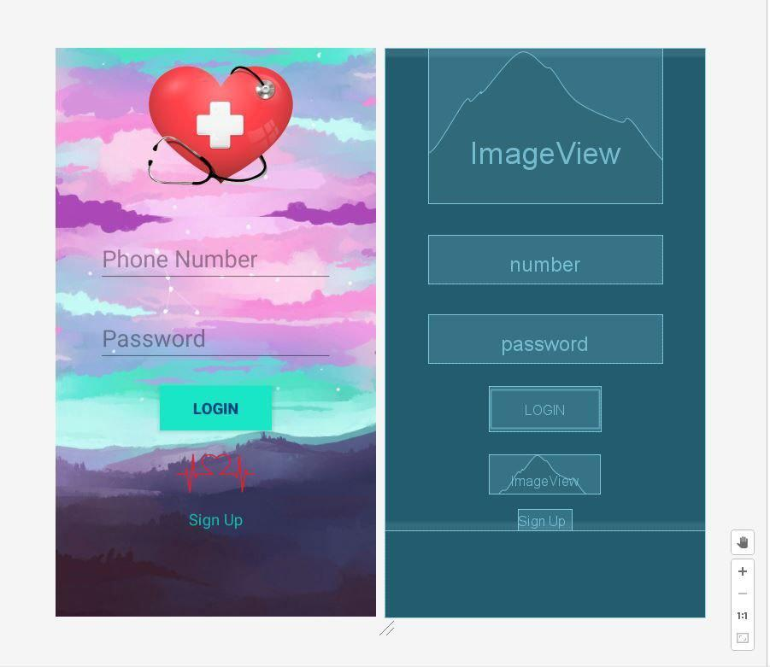
SCREENS
Login page

Slide 10
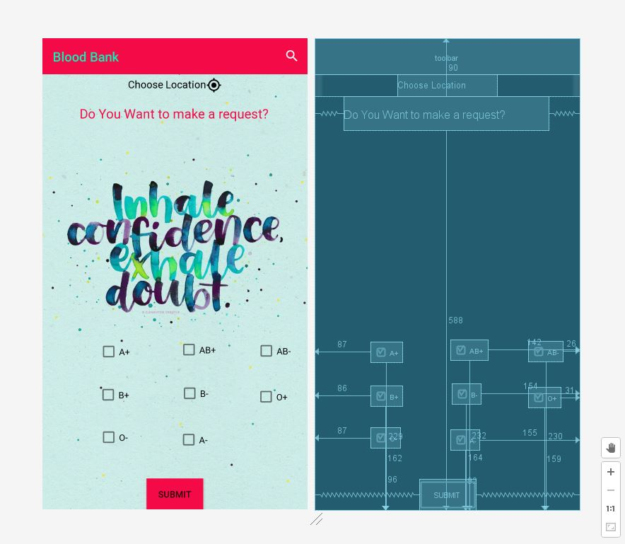
Request page

Slide 11
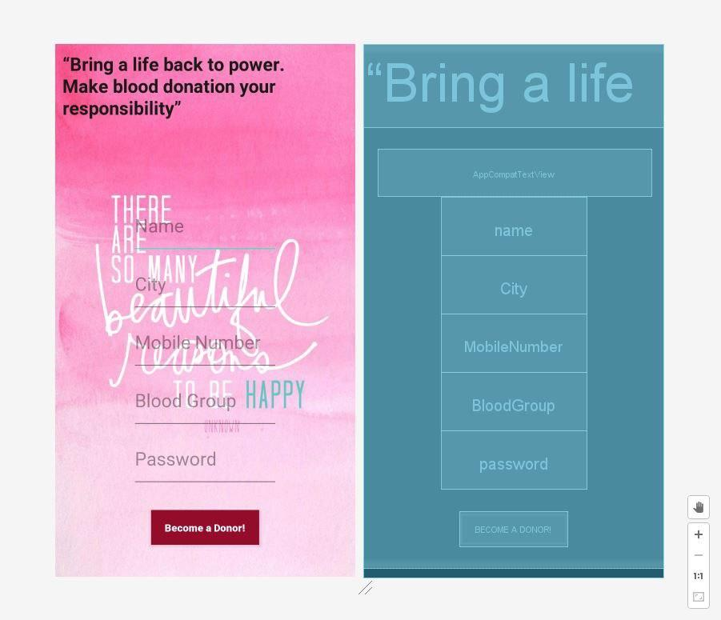
Donor Registration

Slide 12
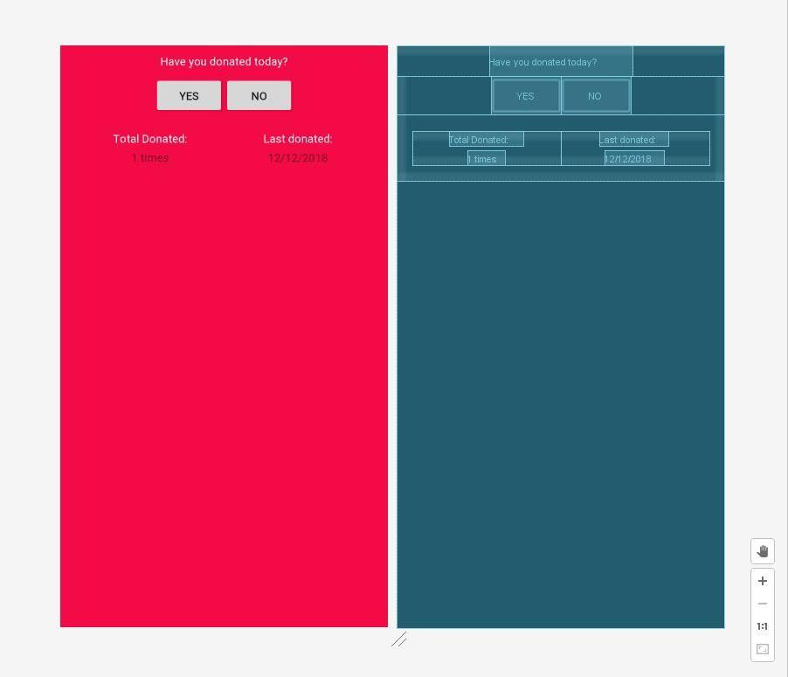
Profile Details

